Slide 1
Change Management:
How to Achieve a Culture of Safety

Slide 2
Objectives
Change Management
List the Eight Steps of Change
Identify errors common to organizational change
Discuss what is involved in creating a
new culture
Begin planning your nursing home’s change strategy

Slide 3
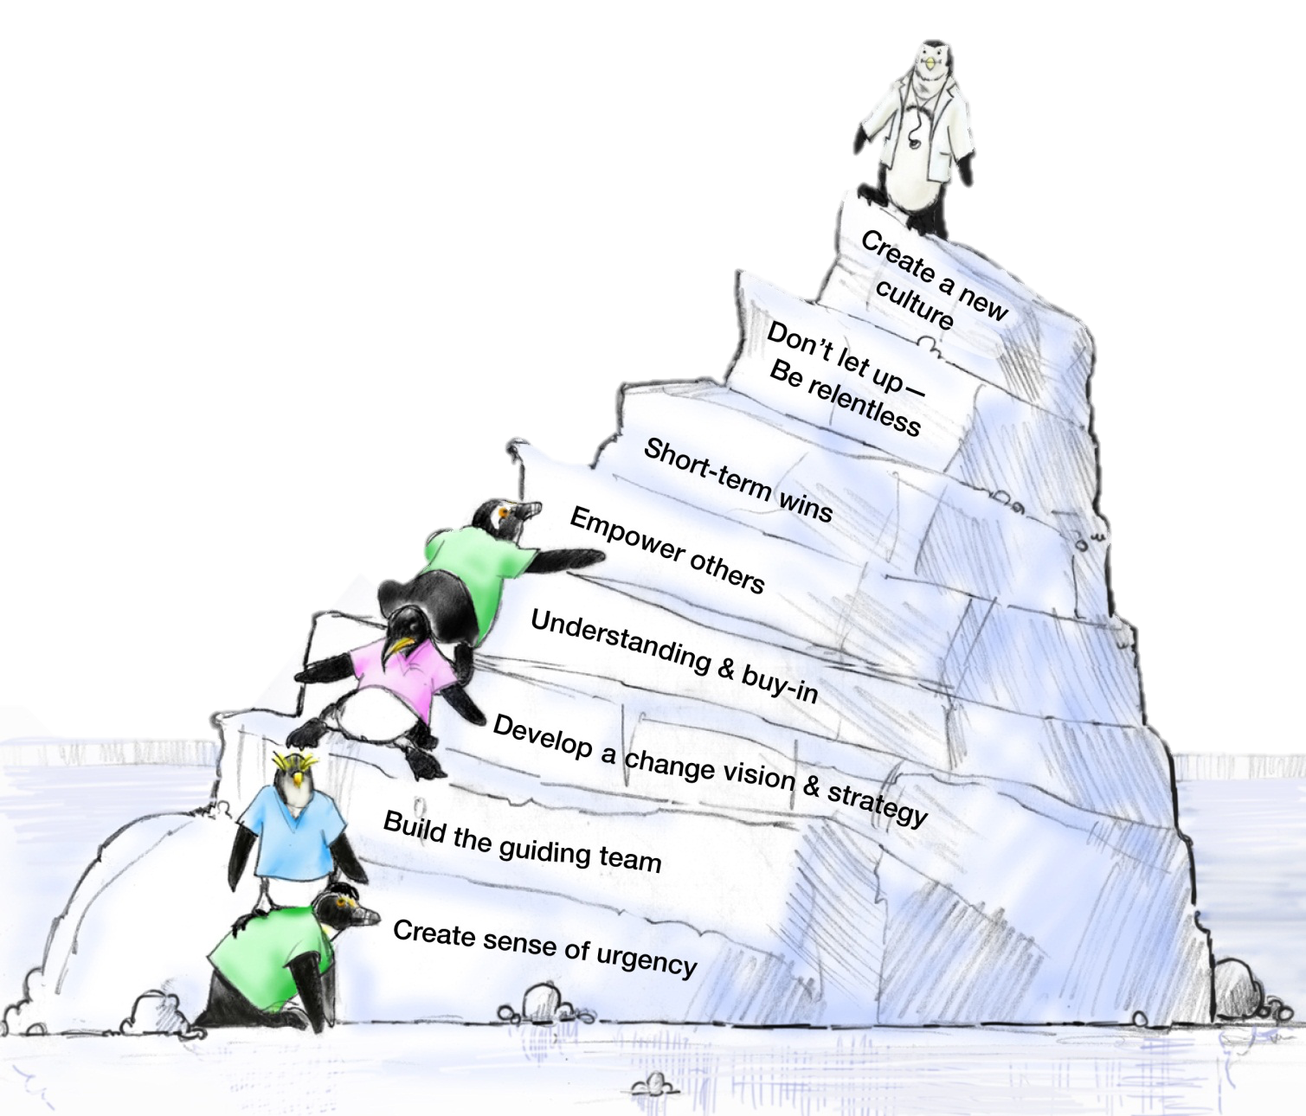
8 Steps of Change
John Kotter

Slide 4
Set the Stage and
Create a Sense of Urgency
Get people’s attention!
Sell the need for change … describe the consequences of not changing
Immerse people in information about the change
Discuss ways to solve the problems people identify with the change
  Empower people to solve the “problem”

Slide 5
Pull Together the Guiding Team
Choose key players, especially staff-level managers
Identify a Guiding Team that is multidisciplinary
Consider the credibility and integrity of change leaders
Choose proven leaders who can drive the change process
  Strong position power, broad expertise, and high credibility
Ensure the Guiding Team has both management and leadership skills
  Management skills control the process
  Leadership skills drive the change

Slide 6
Develop the Change Vision and Strategy
Senior Leadership is responsible for:
Establishing the definition of a “culture of safety” aligned with expectations, core values, and shared beliefs
Informing the nursing home of these values and evaluating the culture
Leading the process of:
  Translating values into expected behaviors
  Establishing trust and accountability
Communicating a commitment to shaping the culture

Slide 7
Communicate for Understanding and Buy-In
Provide supportive actions for fear, anger, and resistance
Encourage discussion, dissent, disagreement, debate—keep people talking
Tell people what you know―and what you don’t know
Acknowledge concerns, perceived losses, and anger
Model the expected behaviors
Value resisters
  They clarify the problem and identify other problems
  that need to be solved first
  Their tough questions can strengthen and improve the change
  They may be right―it is a dumb idea!

Slide 8
Empower Others to Act
Provide direction
Allow others to find their own team-driven solutions
Encourage others to speak up and take risks
Share the information you know
Encourage teamwork and collaboration
Encourage personal reflection and learning
Train employees so they have the desired skills and attitudes
Track activities and progress
Set short-term goals

Slide 9
Produce Short-Term Wins
Show visible success; further impetus for change
Provide positive feedback; recognize and reward contributions to wins
  Further builds morale and motivation
Leverage lessons learned to help plan next goal
Create greater difficulty for resisters to block further change
Provide leadership with evidence of success
Build momentum
  Helps draw in neutral or reluctant supporters

Slide 10
Don’t Let Up
Acknowledge hard work
Celebrate successes and accomplishments
Reaffirm the vision
Bring people together toward the vision
Acknowledge what people have left behind
Develop long-term goals and plans
Provide tools and training to reinforce new behaviors
Reinforce and reward the new behaviors
Create systems and structures that reinforce new behaviors
Prepare people for the next change

Slide 11
Create a New Culture
Develop action steps for stabilizing, reinforcing, and sustaining the change:
  Give people time to mourn their actual losses
  Provide skill and knowledge training
  Develop new reward systems
  Recognize and celebrate accomplishments
Develop performance measures to continually monitor the results from the change and to identify opportunities for further improvements
Make adjustments to the change vision and strategy to reflect new learning and insights
Encourage people to be open to new challenges, forces, and pressures for the next change

Slide 12
Errors Common to
Organizational Change
Allowing for complacency
Failing to create a sufficiently powerful Guiding Coalition and Change Team
Not truly integrating the vision
Allowing obstacles to block change
Not celebrating short-term wins
Declaring victory too soon
Neglecting to anchor changes firmly
in the culture

Slide 13
Culture Change Comes Last,
Not First!
Most alterations in norms and shared values come at the end of the transformation process
New approaches sink in after success is shown
Feedback and reinforcement are crucial to buy-in
Sometimes the only way to change culture is to change key people
Individuals in leadership positions need to be on board, or the old culture will reassert itself

Slide 14
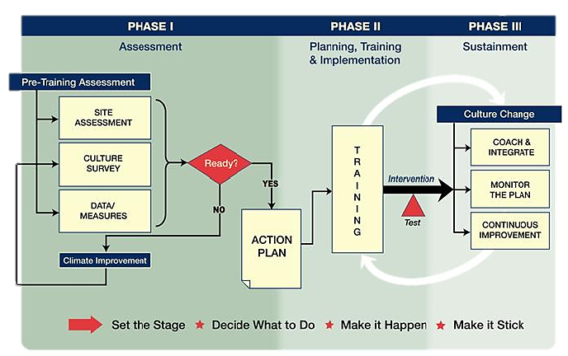
TeamSTEPPS Change Model

Slide 15
Change Management Models
PDSA: Plan, Do (TeamSTEPPS), Study, Act
DMAIC: Define, Measure, Analyze, Improve (TeamSTEPPS), Control
IHI Model for Improvement: Forming the Team, Setting Aims, Establishing Measures, Selecting Changes, Testing Changes, Implementing Changes (TeamSTEPPS), Spreading Changes
CUSP: Assemble the Team, Engage the Senior Executive, Understand the Science of Safety, Identify Defects through Sensemaking, Implement Teamwork and Communication (TeamSTEPPS)
  https://www.ahrq.gov/professionals/education/curriculum-tools/cusptoolkit/index.html

Slide 16
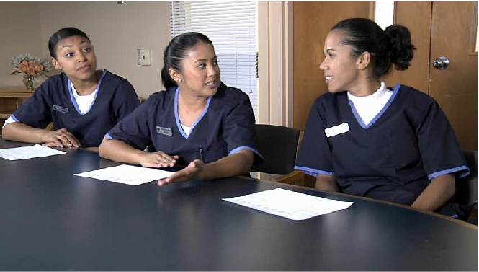

On-Time Quality
Improvement Model

Slide 17
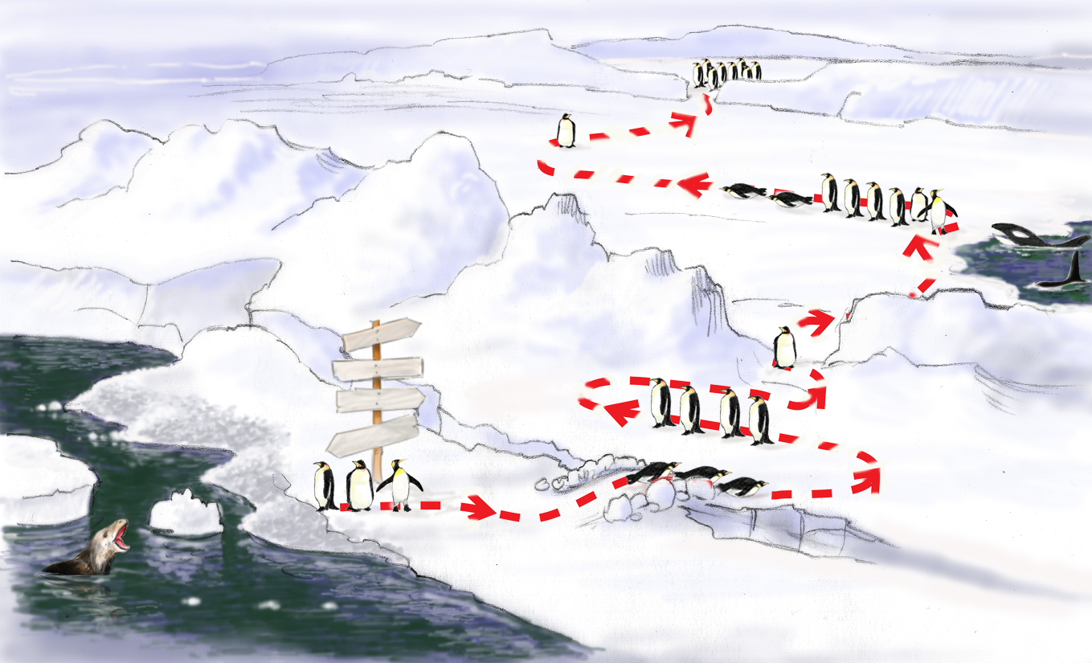

Roadmap to a Culture of Safety
Monitor, Integrate, Continuous Process Improvement
Celebrate Wins! Staying the Course
Sustaining
Implement Action Plan, Train, Empower Others
Test Intervention
(Outcomes)
TeamSTEPPS
Change
Coaching
I’m staying right here. Yeah, they’ll be back.
What are they doing?
Joint Commission
Develop Action Plan
Status QUO
Why do we need change?
FUTURE
Errorville
Prepare
the Climate
Catalytic Event Drives Need For Change
Build Team, Strategy, Buy-In, Establish Goals

