Slide 1
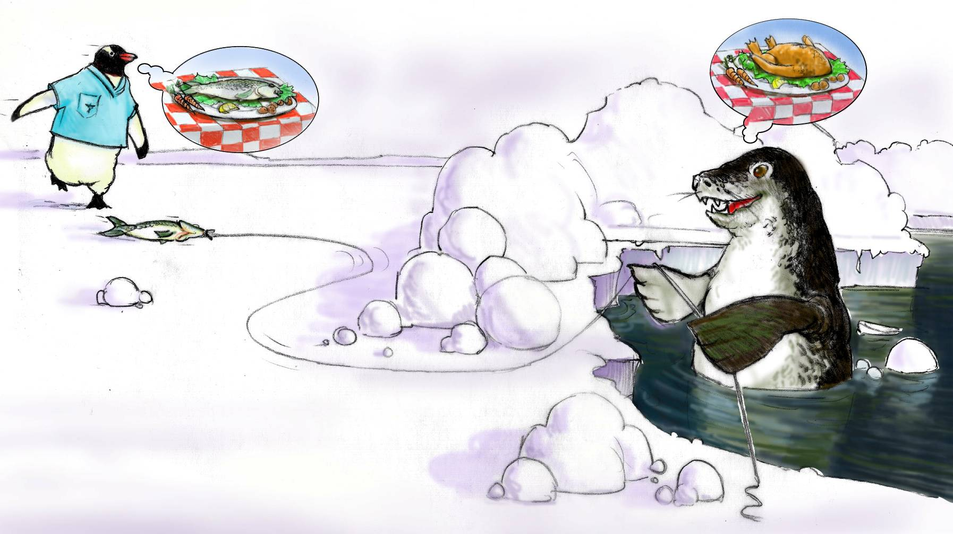
Situation Monitoring

Slide 2
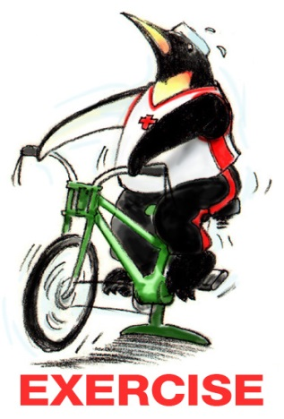
Teamwork Exercise #2

Slide 3
Objectives
Discuss how situation monitoring affects team processes and outcomes
List components of the STEP mnemonic
Explain situation awareness and identify undermining conditions
Define a shared mental model and how it is cultivated within a team

Slide 4
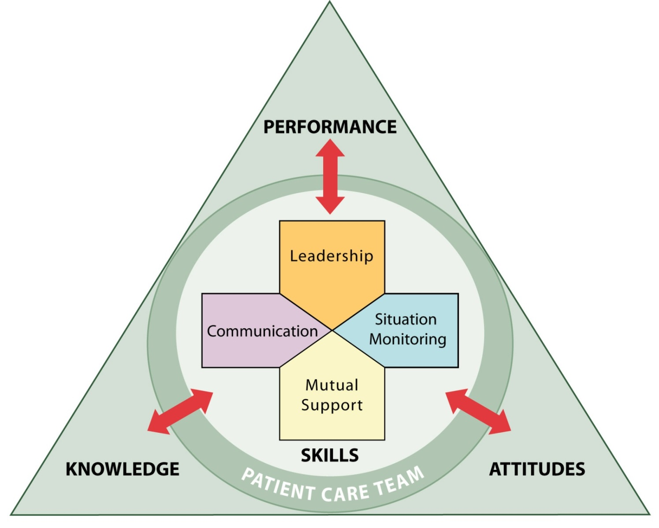
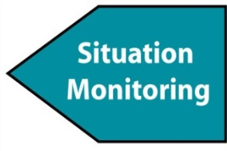
Situation Monitoring
Ensures new or changing information is identified for communication and decision-making
Leads to effective support of fellow team members

Slide 5

A Continuous Process
Situation
Monitoring
(Individual Skill)
Situation
Awareness
(Individual Outcome)
Shared
Mental Model
(Team Outcome)

Slide 6
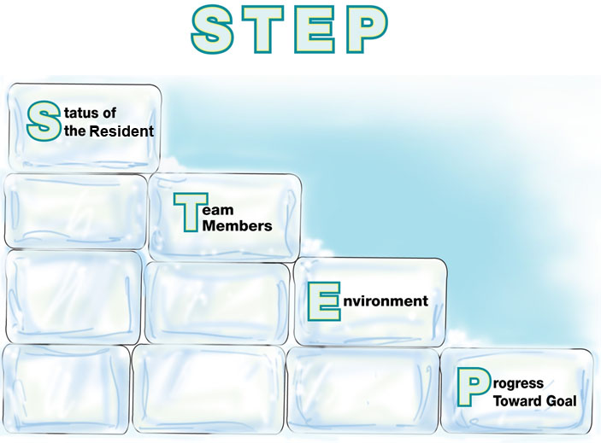
Components of Situation Monitoring:

Slide 7
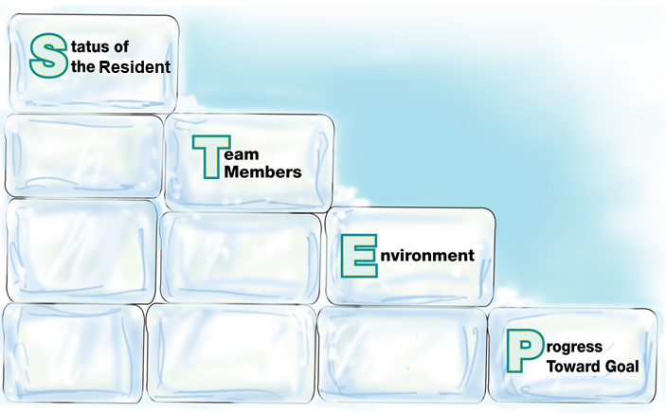

Status of the Resident
Resident History
Vital Signs
Medications
Physical Exam
Plan of Care
Psychosocial Condition

Slide 8
Team Members
Fatigue
Workload
Task Performance
Skill Level
Stress Level

Slide 9
I’M SAFE Checklist
I = Illness
M = Medication
S = Stress
A = Alcohol and Drugs
F = Fatigue
E = Eating and Elimination

Slide 10
Environment
Facility Information
Administrative Information
Human Resources
Acuity of residents and other team members’ assignments
Equipment

Slide 11
Progress Toward Goal
Call a Huddle!
Status of Team’s Resident(s)
Goal of Team
Tasks/Actions That Are or Need To Be Completed
Plan Still Appropriate

Slide 12

Situation Monitoring Exercise
  Mrs. Johnson, who uses a walker, falls while trying to walk independently to her bathroom. Her head is bleeding and she has fallen directly on her hip. A nurse and a nursing assistant hear Mrs. Johnson cry for help and immediately go to her room. Nancy, the nurse, promptly assesses Mrs. Johnson. Nancy calls the nursing station and asks them to call EMS and Mrs. Johnson’s physician immediately. Nancy then directs Judy, the nursing assistant, to retrieve 4x4 gauze from the treatment cart. David, another nursing assistant, sees Judy urgently leaving Mrs. Johnson’s room and goes in to see if he can help. Upon his arrival, Nancy tells him to maintain C-spine precautions until EMS arrives. Noticing David’s confused expression, Nancy explains, “Place one hand on each side of Mrs. Johnson’s
  head and keep it in straight alignment with her spine.”

Slide 13
Situation Awareness is…
The state of knowing the current conditions affecting one’s work.
  Includes knowing…
  Status of the resident
  Status of other team members
  Environmental conditions
  Current progress toward the goal

Slide 14
Conditions That Undermine
Situation Awareness
  Failure to—
  Share information with the team
  Request information from others
  Direct information to specific team members
  Include resident or family in communication
  Utilize resources fully (e.g., status board, automation)
  Maintain documentation
  Know and understand where to focus attention
  Know and understand the plan
  Inform team members the plan has changed

Slide 15

A Shared Mental Model is…
The perception of, understanding of, or knowledge about a situation or process that is shared among team members through communication

Slide 16
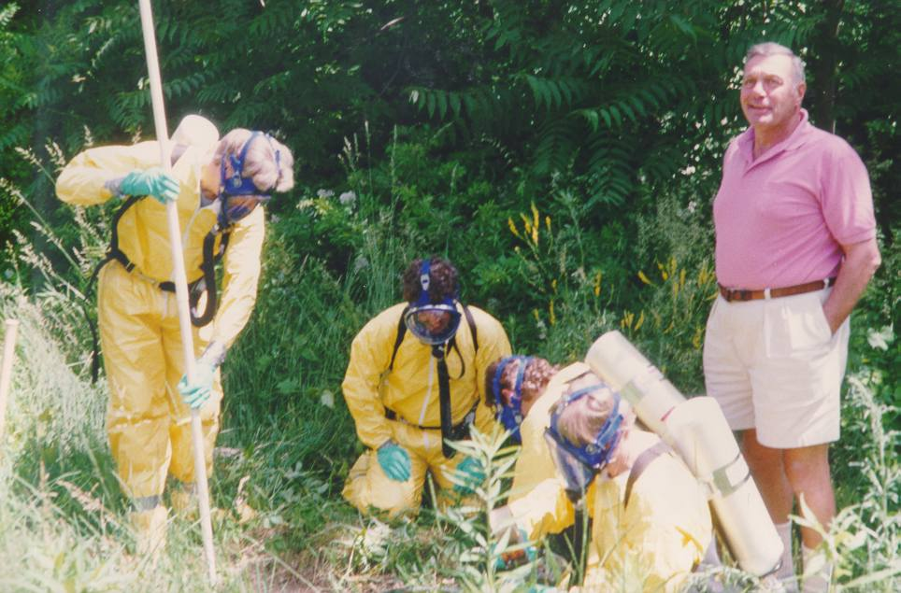
Shared Mental Model?

Slide 17
When and How to Share?
When:
Briefs
Huddles
Debriefs
Transitions in Care
How:
SBAR
Call-outs
Check-backs

Slide 18

Practical Exercise
Gloria Valdez
  New admission
  87 years old
  Dementia diagnosis
  Confused, anxious since admission
  Involved daughter

Slide 19



What Do You See?

Slide 20
How Shared Mental Models
Help Teams
  Lead to mutual understanding of situation
  Lead to more effective communication
  Enable back-up behaviors
  Help ensure understanding of each other’s roles and how they interplay
  Enable better prediction and anticipation of team needs
  Create commonality of effort and purpose

Slide 21
Tools & Strategies Summary
BARRIERS
Inconsistency in Team Membership
Lack of Time
Lack of Information Sharing
Hierarchy
Defensiveness
Conventional Thinking
Complacency
Varying Communication Styles
Conflict
Lack of Coordination and Followup With Coworkers
Distractions
Fatigue
Workload
Misinterpretation of Cues
Lack of Role Clarity
TOOLS and STRATEGIES
  Communication
  SBAR
  Call-Out
  Check-Back
  Handoff
  Leading Teams
  Brief
  Huddle
  Debrief
  Situation Monitoring
  STEP
  I’M SAFE
OUTCOMES
Shared Mental Model
Adaptability
Team Orientation
Mutual Trust
Team Performance
Resident Safety!!

Slide 22
Applying TeamSTEPPS Exercise
Is your teamwork issue related to the team’s or individuals’ skill at monitoring the situation?
If yes, what is the situation monitoring issue?
Which situation monitoring tools and/or strategies might you consider implementing to address the issue?

